Slide 1


Worki project
Software Engineering project for Ariel University

Slide 2
Our application for managers of companies that interested in arranging and organizing shift schedules and sorting employees based on available space.

Slide 3
Manager Permission | Worker Permission

Slide 4

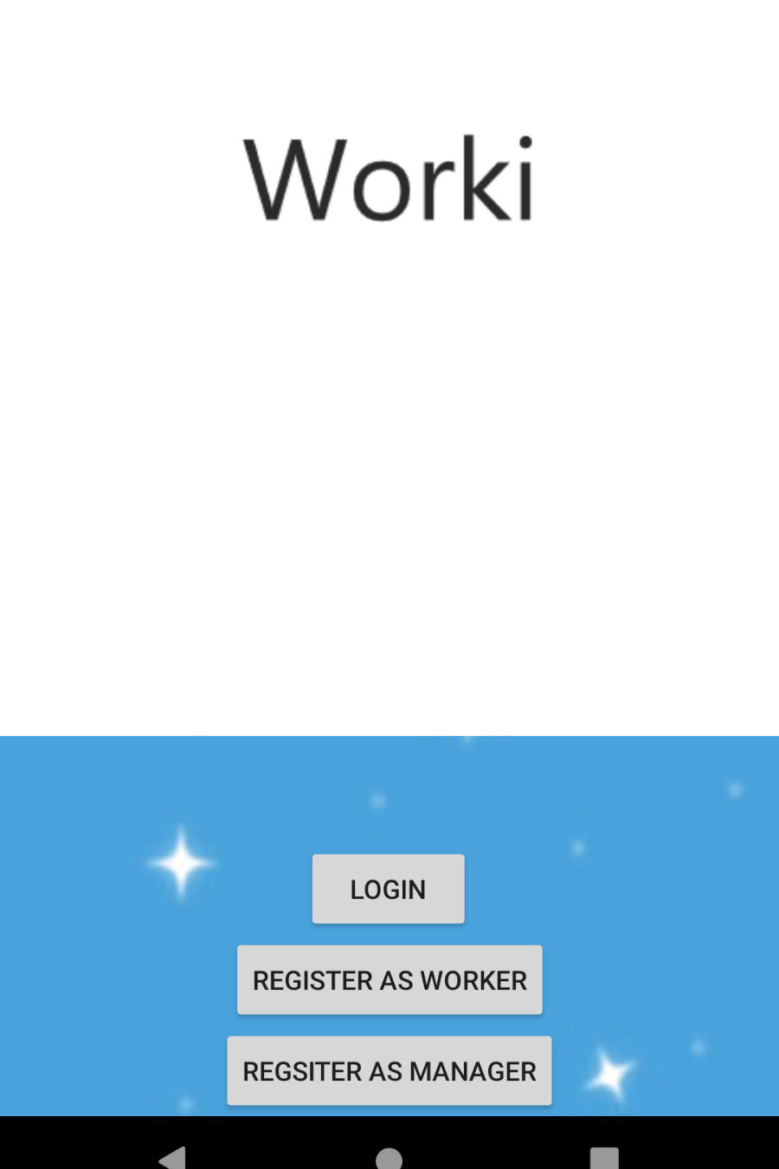
Regsiter- in page
By E-mail & Password

Slide 5
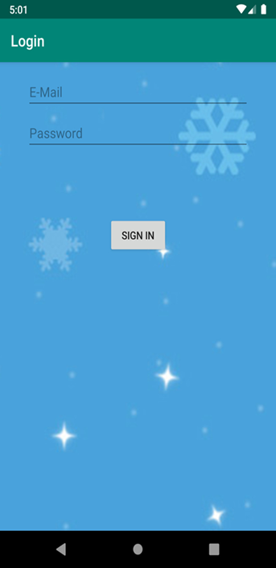
Log- in page
By E-mail & Password

Slide 6

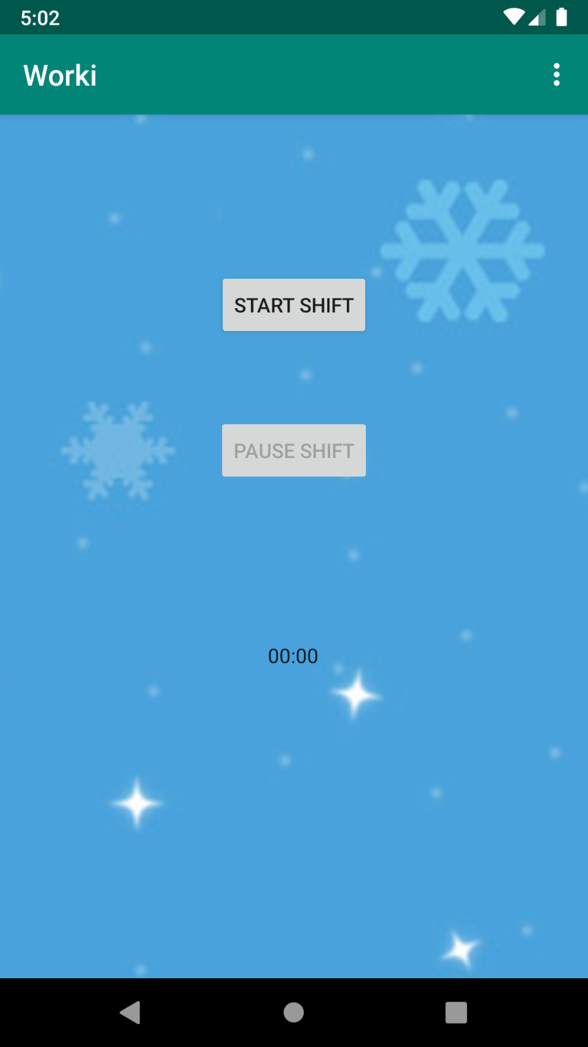
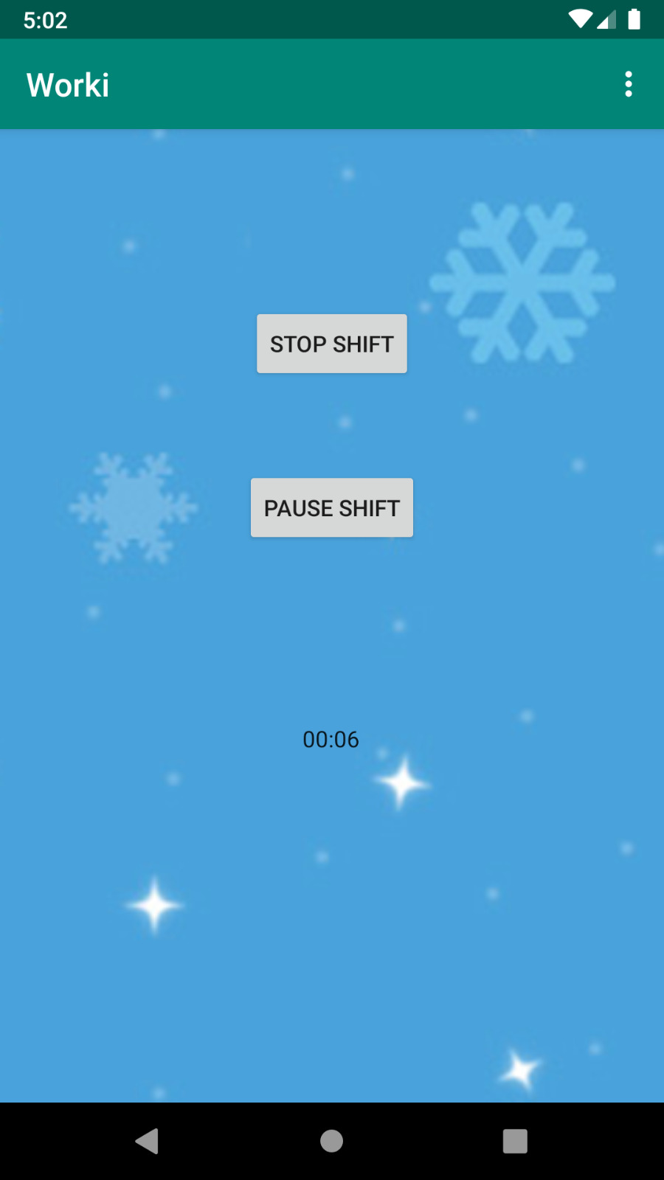
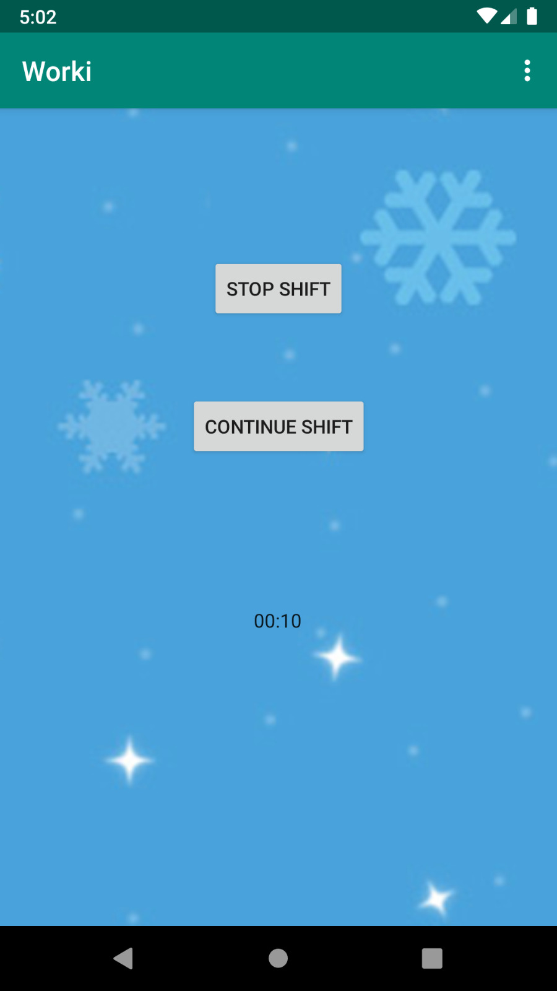
Timer for each Shift
With the option to start/pause/continue/stop the shift

Slide 7
Unified Modeling Language Diagrams:

Slide 8
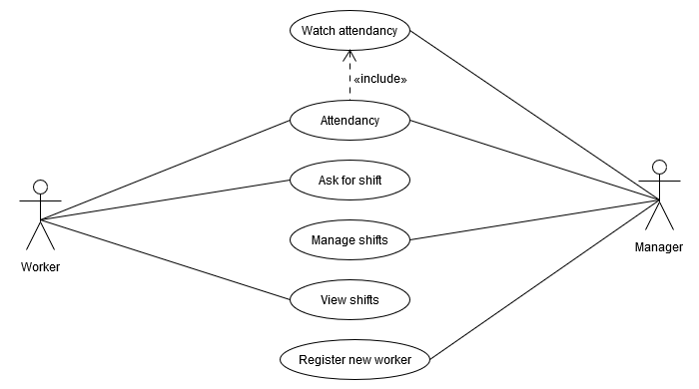
Worki use-case diagram

Slide 9
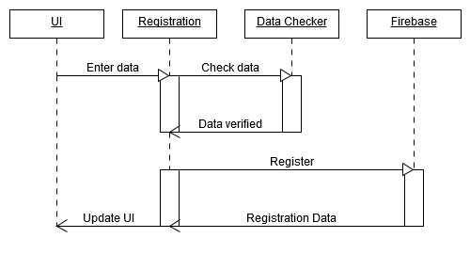
Worki Sequence diagram

Slide 10
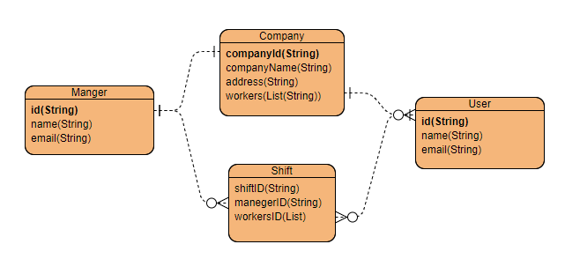
Worki-Entity Relationship Diagram

Slide 12
Link for Github: https://github.com/elishadar/Worki

